Slide 1
EPFL
Space Center eSpace
Space Propulsion
ENG-510

Slide 2
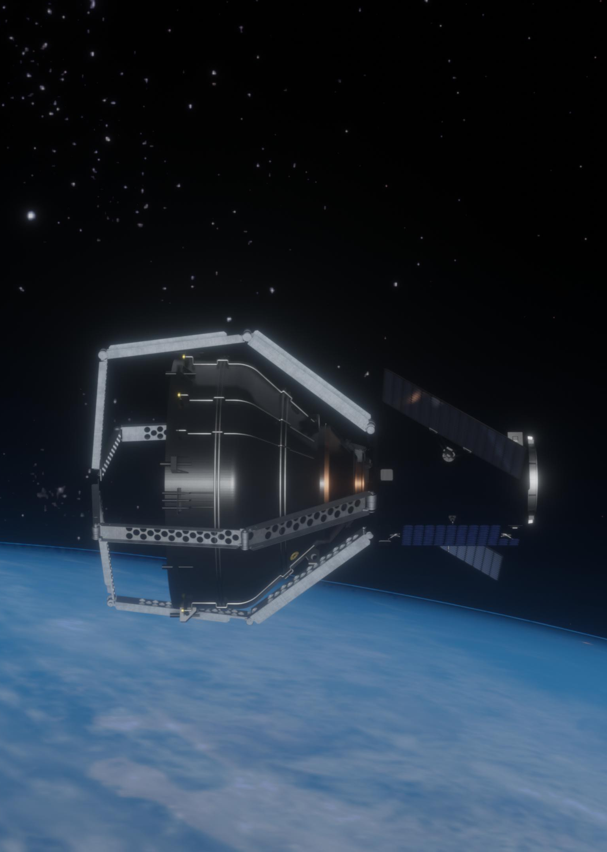
Lecture # 1
Part # 1
Introduction in Spacecrafts
Short highlights of spacecraft design including overview on subsystems

Slide 3
What is Space Propulsion?
Course Idea:
Space propulsion or better in-space propulsion exclusively deals with propulsion systems used in the vacuum of space
In-space propulsion should not be confused with space launch or atmospheric entry
In that sense space or spacecraft propulsion is any method used to accelerate spacecraft / satellites by ejection of material
But in this course, we will also treat propulsion systems designed in order to reach space defined here by the Karman line (at the altitude of 100 km respectively 62 miles)
L1 – Introduction in Spacecrafts
Space Propulsion ENG-510

Slide 4
What is Space Propulsion?
Course Idea:
So-called Karman line is a working definition for the boundary of aeronautics and astronautics. Theodore von Karman has calculated that at this altitude a vehicle needs to travel faster than his orbital velocity in order to get sufficient aerodynamic lift from the atmosphere to support itself
Spacecrafts could travel on a trajectory, a non-stable flight path, i.e. the vehicle returns to earth due to gravity (similar on other planets)
Or Spacecraft could be in an orbit, an orbit is a stable trajectory around the earth or other planets respectively between planets without the need for additional acceleration, thrust
Karman line @ 100 km splits aero- and astronautics
L1 – Introduction in Spacecrafts
Space Propulsion ENG-510

Slide 5
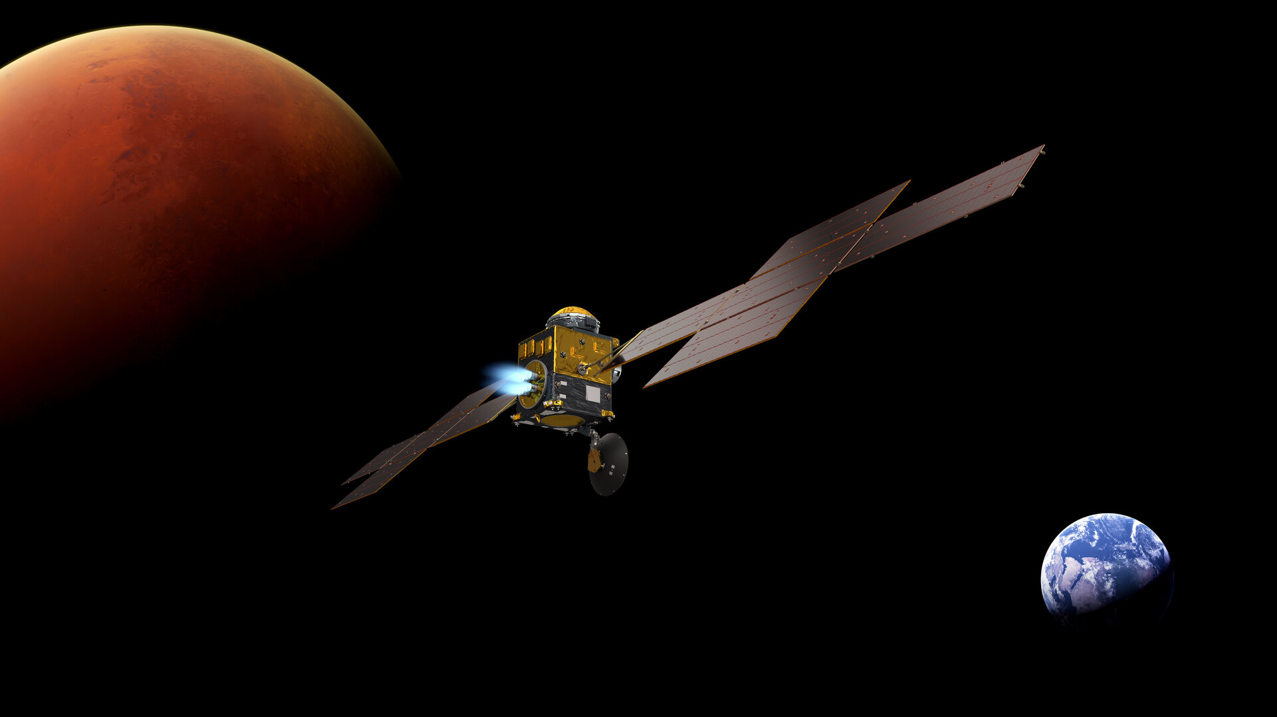
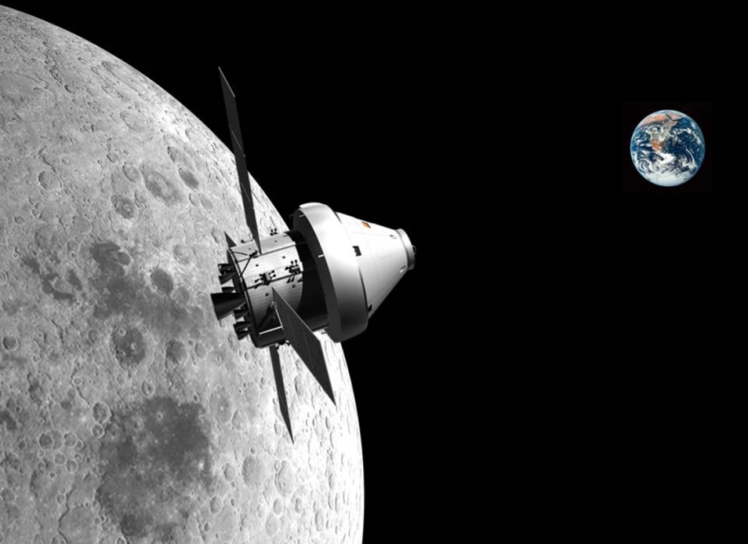
Why learning Spacecraft Design?
L1 – Introduction in Spacecrafts
Space Propulsion ENG-510
ESM
SLS
MSR-ERO

Slide 6
Why learning Spacecraft Design?
Introduction:
Because the objective of the spacecraft mission influences significantly the selection + design of the propulsion subsystem
  Propulsion Systems for launch vehicles (e.g. SLS (Space Launch System) launcher) must fulfill completely different requirements compared to Orion ESM (European Service Module) or MSR-ERO (Mars Sample Return - Earth Return Orbiter)
  SLS launcher needs propulsion system with very high thrust level (lift-off from Earth)
  Orion-ESM needs propulsion system with redundancy (human rated)
  MSR-ERO needs propulsion system with high specific impulse (e.g. transfer Earth to Mars – details will follow in lectures on electric propulsion systems)
L1 – Introduction in Spacecrafts
Space Propulsion ENG-510

Slide 7
Why learning Spacecraft Design?
Introduction:
Because the propulsion subsystems have strong interactions / important I/Fs (Interfaces) with the other subsystems which result in key requirements for all subsystems
  The ESM provides translational and 3 axis attitude control for the spacecraft, stores consumables for the crew module (Oxygen, Nitrogen and Water) and provides power via the solar arrays
  The main subsystems respectively equipment of the ESM are Structure, Thermal Control S/S (Subsystem), Consumable Storage S/S, Propulsion S/S, Power Equipment and Avionic Equipment
L1 – Introduction in Spacecrafts
Space Propulsion ENG-510

Slide 8
Why learning Spacecraft Design?
Introduction:
Roundtable:
  Presentation of students (e.g. your experience with propulsion [member of the EPFL rocket team, others …])
  Questions on course, project
  Feedback
  Main interest w.r.t. space propulsion
  Expectation from course
  AoB
L1 – Introduction in Spacecrafts
Space Propulsion ENG-510

Slide 9
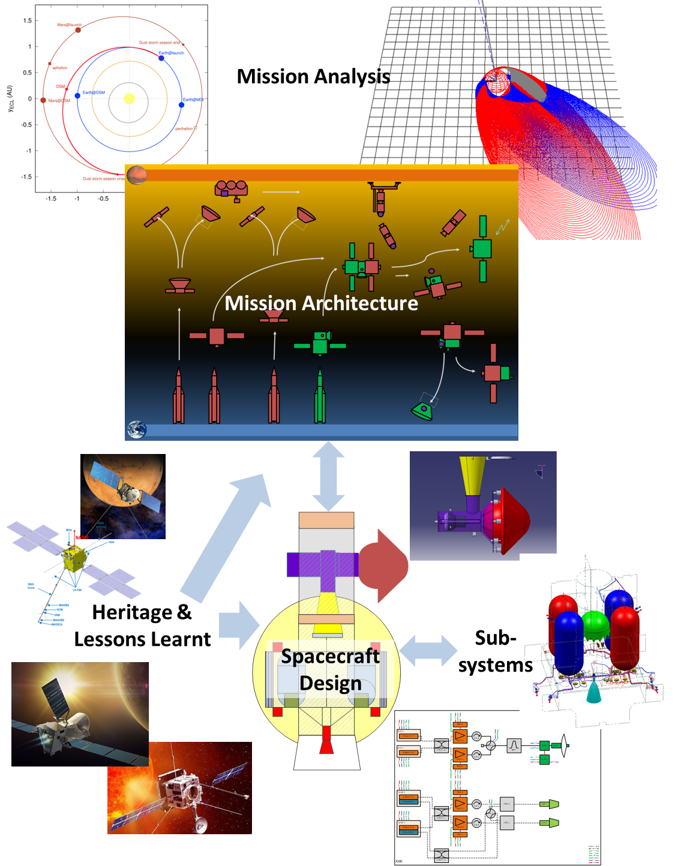
Why learning Spacecraft Design?
Introduction:
And therefore, to understand
everything later in the course
on how to design a propulsion
system…
L1 – Introduction in Spacecrafts
Space Propulsion ENG-510

Slide 10
What is the starting point for S/C design?
Initiation:
An idea
  Launcher – To bring 800 kg of payload into a Low Earth Orbit
  Satellite – To observe Earth weather from a Sun Synchronous Orbit
  Crew Transport Vehicle – To transfer 4 humans to the Lunar Gateway
With Mission Objectives
  Payload – Diameter of 4 m and length of 10 m
  Cost – Transport cost of less than 10.000 U$ / kg
  Schedule – Available in Q4 / 2026
  Environment (political) – No ITAR (International Traffic in Arms Regulations – US export control) restrictions and respect REACH (Registration, Evaluation, Authorization and Restriction of Chemicals) regulations
L1 – Introduction in Spacecrafts
Space Propulsion ENG-510

Slide 11
What is the starting point for S/C design?
Team:
Good team with clear roles and responsibilities!
Diverse team with different personalities, background, experiences, …
Brilliant engineering lead (i.e. CTO (Chief Technical Officer) or chief engineer or system engineer, …)
System Design: The art or the science of making subsystems work together
Propulsion engineer is a key system engineer as one must consider + understand propulsion, thermodynamics (heat loads from combustion chamber), mechanics (structural loads of pressure to tanks), electrics (harness routing to transducer), avionics, design, …
L1 – Introduction in Spacecrafts
Space Propulsion ENG-510

Slide 12
What is the starting point for S/C design?
Organization:
Management
Product Assurance
Engineering
MAIT (Manufacturing, Assembly, Integration, Testing)
Operations
Supply Chain
L1 – Introduction in Spacecrafts
Space Propulsion ENG-510

Slide 13
What is the starting point for S/C design?
Organization:
Management
  Project Manager
  Controlling
  Contracts
  Planning
  Documentation
  Configuration
  Risk
  Interfaces
  Technologies (TRL – Technology Readiness Level / IRL – Integration Readiness Level / SRL – System Readiness Level)
L1 – Introduction in Spacecrafts
Space Propulsion ENG-510

Slide 14
What is the starting point for S/C design?
Organization:
Product Assurance
  Quality Manager
  RAMS (Reliability, Availability, Maintainability, Safety)
  Product Assurance
  Quality Assurance (lessons learned)
L1 – Introduction in Spacecrafts
Space Propulsion ENG-510

Slide 15
What is the starting point for S/C design?
Organization:
Engineering
  System Engineer
  Functional Engineering
  Mechanical Engineering
  Thermal Engineering
  Electrical Engineering
  Software Engineering
  Design Engineering
L1 – Introduction in Spacecrafts
Space Propulsion ENG-510

Slide 16
What is the starting point for S/C design?
Organization:
MAIT
  Manufacturing
  Assembly
  Integration
  Test
  Quality Inspection
  Operations
  Logistics
  Operations
  Ground Systems
L1 – Introduction in Spacecrafts
Space Propulsion ENG-510

Slide 17
What is the starting point for S/C design?
Organization:
Supply Chain
  Procurement
  Subcontractor Manager
  Technical Authority
L1 – Introduction in Spacecrafts
Space Propulsion ENG-510

Slide 18
What is the starting point for S/C design?
Organization:
Triangle Project Manager, Quality Manager, System Engineer responsible for on-time, on-quality and on-cost delivery (OTOQOC)
How is the decision process defined?
Who is allowed to take decisions?
L1 – Introduction in Spacecrafts
Space Propulsion ENG-510

Slide 19
What is the starting point for S/C design?
Recap on Organization Principles:
System engineering is an iterative process
You need to check every number
A propulsion engineer must be a very good system engineer
Recap: Important is clear organization with minor optimization
L1 – Introduction in Spacecrafts
Space Propulsion ENG-510

Slide 20
How does the design process work?
Process Flow:
Space Mission Analysis and Design Process (from SMAD)
  Mission Characterization
  Mission Evaluation
  Requirements Definition
  Space Mission Geometry
  Orbit and Constellation Design (Astrodynamics)
  Space Environment and Survivability
  Space Payload Design and Sizing
  Spacecraft Design and Sizing
  Spacecraft Subsystems
  Space Manufacture and Test
L1 – Introduction in Spacecrafts
Space Propulsion ENG-510

Slide 21
How does the design process work?
Process Flow:
Space Mission Analysis and Design Process
  Communications Architecture
  Mission Operations
  Ground System Design and Sizing
  Spacecraft Computer Systems
  Space Manufacturing and Reliability
  Cost Modeling
L1 – Introduction in Spacecrafts
Space Propulsion ENG-510

Slide 22
How does the design process work?
Project Phases:
Phase 0 – Conceptual mission study
Phase A – Feasibility study
Phase B – Design definition
Phase C – Detailed definition
Phase D – Qualification, Production
Phase E – Operation
Phase F – Disposal
L1 – Introduction in Spacecrafts
Space Propulsion ENG-510

Slide 23
How does the design process work?
System Engineering Tasks in Project Phases:
Phase 0 – Conceptual mission study
  End point: MDR (Mission Definition Review)
  Mission definition
  High level specifications
L1 – Introduction in Spacecrafts
Space Propulsion ENG-510

Slide 24
How does the design process work?
System Engineering Tasks in Project Phases:
Phase A – Feasibility study, design trade-offs, preliminary design
  End point: PRR (Preliminary Requirements Review)
  Preliminary system functional analysis
  Specifications and function trees
  Technology identification
  System design trade-offs
  Preliminary baseline design
  Preliminary AIV (Assembly, Integration, Validation) plan
L1 – Introduction in Spacecrafts
Space Propulsion ENG-510

Slide 25
How does the design process work?
System Engineering Tasks in Project Phases:
Phase B – Design definition, component tests, system and subsystem level specifications
  Intermediate point: SRR (System Requirements Review)
  End point: PDR (Preliminary Design Review)
  Consolidation of system specifications: requirements traceability matrix
  Preliminary subsystem specifications
  Technologies consolidation
  System design consolidation: preliminary ICD (Interface Control Document)
  Risk analysis
  Phase C/D AIV plan
L1 – Introduction in Spacecrafts
Space Propulsion ENG-510

Slide 26
How does the design process work?
System Engineering Tasks in Project Phases:
Phase C – Detailed definition, subsystem and system tests, final specifications
  End point: CDR (Critical Design Review)
  Final specifications
  Detailed system design (ICD)
  System performance and sensitivity analysis, detailed analytical simulations
  AI & tests of engineering models
  QA and safety analysis
  Detailed AIV plan
  Preliminary operations manual (user manual)
L1 – Introduction in Spacecrafts
Space Propulsion ENG-510

Slide 27
How does the design process work?
System Engineering Tasks in Project Phases:
Phase D – Qualification and acceptance tests, flight production, integration
  Intermediate point: QR (Qualification Review)
  End point: AR (Acceptance Review)
  Assembly, integration and qualification tests of qualification model
  Detailed integration and test procedures
  Verification of requirements
  Consolidated operations manual
  Acceptance tests
L1 – Introduction in Spacecrafts
Space Propulsion ENG-510

Slide 28
How does the design process work?
System Engineering Tasks in Project Phases:
Phase E – Operation
  End point: FR (Flight Review) / OPR (Operation Readiness Review)
  Support launch campaign
  Performance evaluation
  Disposal plan
  Support anomaly investigations recovery
L1 – Introduction in Spacecrafts
Space Propulsion ENG-510

Slide 29
How does the design process work?
System Engineering Tasks in Project Phases:
Phase F – Disposal
  End point: Contract closure / End of Life
  Systems shut-down (Re-entry, graveyard orbit, …)
  Transfer of ground H/W means
  Storage
  Exhibition, museum
  Destruction
L1 – Introduction in Spacecrafts
Space Propulsion ENG-510

Slide 30
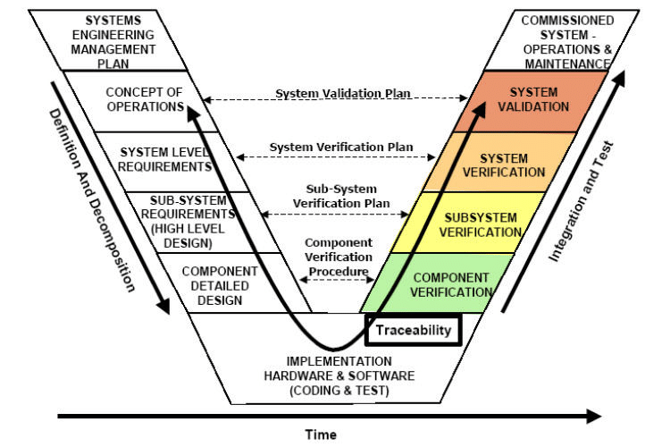
How does the design process work?
Project Phases:
A lot of descriptions, pictures can be found in standards like ECSS (European Cooperation for Space Standardization) on system engineering, project phases, design processes, …
The V-model
L1 – Introduction in Spacecrafts
Space Propulsion ENG-510

Slide 31
How does the design process work?
Project Phases: The V-model continued…
PRR
L0 FRR
L1 – Introduction in Spacecrafts
SRR
Space Propulsion ENG-510
L0 AR
L0 PDR
L0 CDR
L0 QR
L1 PDR
L1 CDR
L1 QR

Slide 32
How does the design process work?
Project Phases: But also the U-model…
PRR
L0 FRR
L1 – Introduction in Spacecrafts
SRR
L0 AR
Space Propulsion ENG-510
L0 PDR
L1 PDR
L0 CDR
L1 CDR
L0 QR
L1 QR
L1 PDR
L1 CDR
L1 QR

Slide 33
How does the design process work?
Project Phases: Or the improved V-model…
PRR
L0 FRR
L1 – Introduction in Spacecrafts
SRR
L0 AR
Space Propulsion ENG-510
L0 PDR
L0 CDR
L0 QR
L1 PDR
L1 CDR
L1 QR

Slide 34
How does the design process work?
Reality versus Theory:
Information on the last slides is out of textbooks on ‘classical’, ‘good’ project organization and system engineering process
This approach can lead to slow and expensive project execution
There are also faster (and cheaper) ways which are today demonstrated quite often by start-ups
Documentation versus achievements / progress
Example 1: Former SpaceX executive on review participation
Example 2: Worst US supplier ever
Example 3: CLDP
L1 – Introduction in Spacecrafts
Space Propulsion ENG-510

Slide 35
Which System Engineering tools & methods exist?
Project Analysis:
An idea
  Launcher – To bring 800 kg of payload into a Low Earth Orbit
With Mission Objectives
  Payload – Diameter of 4 m and length of 10 m
  Cost – Transport cost of less than 10.000 U$ / kg
  Schedule – Available in Q4 / 2025
  Constraints / Environment (political) – No ITAR restrictions and respect REACH regulations
L1 – Introduction in Spacecrafts
Space Propulsion ENG-510

Slide 36
Which System Engineering tools & methods exist?
Functional Analysis:
Functional analysis provides a non-quantitative, ordered description of tasks which a system must perform
As an example of a functional analysis for launcher propulsion is the definition of the main functions as follows:
  F1: To generate Thrust
    F1.1: To store Propellant
  F2: To transmit Loads
  F3: To gimbal Thrust
L1 – Introduction in Spacecrafts
Space Propulsion ENG-510

Slide 37
Which System Engineering tools & methods exist?
Phase-by-Phase Analysis:
Phase-by-phase analysis defines the order of events and provides the basis for separation of environment (e.g. ground phase, lift-off phase, free flight, ignition + boost phase, …)
L1 – Introduction in Spacecrafts
Space Propulsion ENG-510

Slide 38
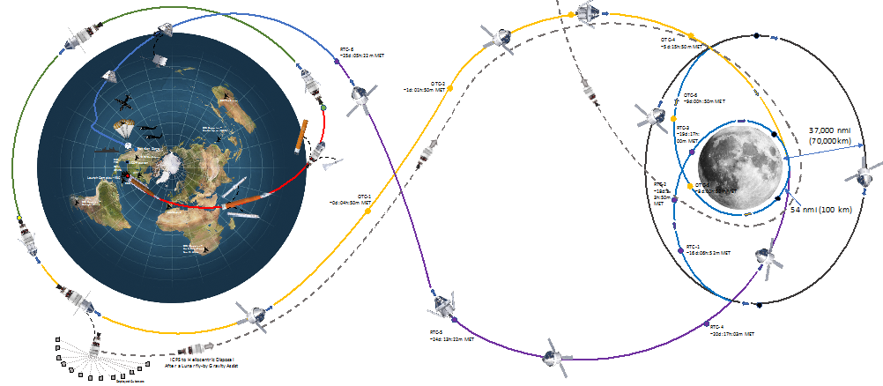
Which System Engineering tools & methods exist?
Project Analysis:
An idea
  Launcher – To bring 800 kg of payload into a Low Earth Orbit
With Mission Objectives
  Payload – Diameter of 4 m and length of 10 m
  Cost – Transport cost of less than 10.000 U$ / kg
  Schedule – Available in Q4 / 2025
  Constraints / Environment (political) – No ITAR restrictions and respect REACH regulations
L1 – Introduction in Spacecrafts
Space Propulsion ENG-510

Slide 39
Which System Engineering tools & methods exist?
System Analysis:
System analysis identifies the needed elements to fulfill the mission objectives and provides the foundation for defining the system architecture
As an example of a system analysis for launcher propulsion is the definition of the main elements as follows:
  Engine
  Propellant Tank
  Gimbal
  Feed Lines
L1 – Introduction in Spacecrafts
Space Propulsion ENG-510

Slide 40
Which System Engineering tools & methods exist?
Functional Matrices:
Based on functional analysis, phase-by-phase analysis and system analysis it is possible to prepare functional matrices:
  Functions versus Products
  Functions versus Phases
L1 – Introduction in Spacecrafts
Space Propulsion ENG-510
Function | Tank | Tubing | Thruster | FDV
F1.1 To load propellant | X | X |  | X
F1.2 To store propellant | X | X
Function | Ground | Flight | P/L sep
F1.1 To load propellant | X
F1.2 To store propellant | X | X | X

Slide 41
Which System Engineering tools & methods exist?
Dimensioning Cases:
Functional matrices support the preparation of dimensioning cases (per product versus the different phases)
  Propellant Tanks Ground Phase
    Acceleration 1 g to 2 g
    Pressure 2 bar to 20 bar
    Temperature 263 K to 293 K
    Propellant mass 0 kg to 5000 kg
  Propellant Tanks Lift-off Phase
    Acceleration 1 g to 5 g
    Pressure 20 bar + / - 1bar
    Temperature 288 K + / - 5 K
    Propellant mass 5000 kg + / - 50 kg
L1 – Introduction in Spacecrafts
Space Propulsion ENG-510

Slide 42
Which System Engineering tools & methods exist?
WBS / PBS / OBS:
WBS – Work Breakdown Structure is a deliverable-oriented breakdown of a project into smaller components in project management / systems engineering a project into smaller components
A WBS is a key project deliverable that organizes the team's work into manageable sections. A WBS element may be a product, data or service or any combination of these
A WBS also provides the necessary framework for detailed cost estimation and control while providing guidance for schedule development and control and is described by WPDs (Work Package Descriptions) defining input, output, tasks, schedule, risks, assumptions, exclusions
L1 – Introduction in Spacecrafts
Space Propulsion ENG-510

Slide 43
Which System Engineering tools & methods exist?
WBS / PBS / OBS:
PBS – Product Breakdown Structure is, in project management, a tool for analyzing, documenting and communicating the outcomes of a project, and forms part of the product-based planning technique.
This diagrammatic representation of project outputs provides a clear and unambiguous statement of what the project is to deliver.
The PBS is identical in format to the WBS, but is a separate entity and is used at a different step in the planning process. The PBS precedes the WBS and focuses on cataloguing all the desired outputs (products) needed to achieve the goal of the project
L1 – Introduction in Spacecrafts
Space Propulsion ENG-510

Slide 44
Which System Engineering tools & methods exist?
WBS / PBS / OBS:
OBS – Organizational Breakdown Structure is a depiction of the project organization arranged to indicate the reporting relationships within the project context
The OBS reflects the way the project is functionally organized. It is a direct representation and description of the hierarchy and organizations that will provide resources to plan and perform work identified in the WBS
The OBS helps management focus on establishing the most efficient organization, by taking into consideration availability and capability of management and technical staff including subcontractors, to achieve project objectives
L1 – Introduction in Spacecrafts
Space Propulsion ENG-510

Slide 45
Which System Engineering tools & methods exist?
Trees:
Trees are an important element to structure, organize a project
  Product tree / Levels
  Specification tree (i.e. requirements tree)
L1 – Introduction in Spacecrafts
Space Propulsion ENG-510
System mass
Engine mass
Tank mass
Structure mass
PMD mass
PMD (Propellant Management Device)

Slide 46
Which System Engineering tools & methods exist?
Requirements:
Requirements must be clear in its description and only contain one requirement at once
Requirements must be verifiable
Specific for launcher propulsion is the definition of requirements as follows:
  L0: Propulsion System dry mass shall be less than 1500 kg
  L1: Engine dry mass shall be less than 200 kg
  L1: Propellant Tank dry mass shall be less than 400 kg
L1 – Introduction in Spacecrafts
Space Propulsion ENG-510

Slide 47
Which System Engineering tools & methods exist?
Budgets:
In order to define L1 requirements based on L0 requirements it is helpful to prepare budgets (e.g. mass budget, propellant budget, power budget, pressurant budget, …) to provide allocation to the different components as well as definition of System margins and uncertainties
Specific for launcher propulsion is the definition of budgets as follows:
  L0: Propulsion System dry mass shall be less than 1500 kg
  L1: Engine dry mass shall be less than 200 kg (+ 20 % uncertainty @ PDR)
  L1: Propellant Tank dry mass shall be less than 400 kg (+ 10 % uncertainty @ CDR)
  L1: System margin 900 kg
L1 – Introduction in Spacecrafts
Space Propulsion ENG-510

Slide 48
Which System Engineering tools & methods exist?
Verifications:
Requirements can be verified by analysis, test, demonstration or review of design (or by a combination out of these methods)
Also, it is important to identify on which level the verification is performed (L0, L1, L2, …)
Specific for launcher propulsion is the definition of verification methods as follows:
  L1: Engine dry mass shall be less than 200 kg (+ 20 % uncertainty @ PDR) is verified by RoD (Review of Design) @ PDR (Mass estimation out of CATIA design) and by demonstration @ CDR (Mass weight of first EM (Engineering Model))
L1 – Introduction in Spacecrafts
Space Propulsion ENG-510

Slide 49
Which System Engineering tools & methods exist?
Model Philosophy:
Model philosophy is derived following the requirements review as well as verification logic
  BB – Breadboard Model using industrial components
  DM – Development Model shall consider first design elements
  EM – Engineering Model shall be similar to PDR configuration
  QM – Qualification Model shall be consistent to analytical verified configuration
  FM – Flight Model shall be similar to qualified configuration
L1 – Introduction in Spacecrafts
Space Propulsion ENG-510

Slide 50
Which System Engineering tools & methods exist?
Trades:
An important element for defining the system configuration are trade-offs
A trade-off shall compare different solutions and shall produce a rigorous evaluation to foster decisions
A standard trade-off format shall be defined at the beginning of the project to ease the trade-off (considering schedule, risk, cost, performance as key parameter with different weighting factors and clear values like 0 to 10)
Trade-offs shall be completed by robustness analysis considering equal weighting factors
L1 – Introduction in Spacecrafts
Space Propulsion ENG-510

Slide 51
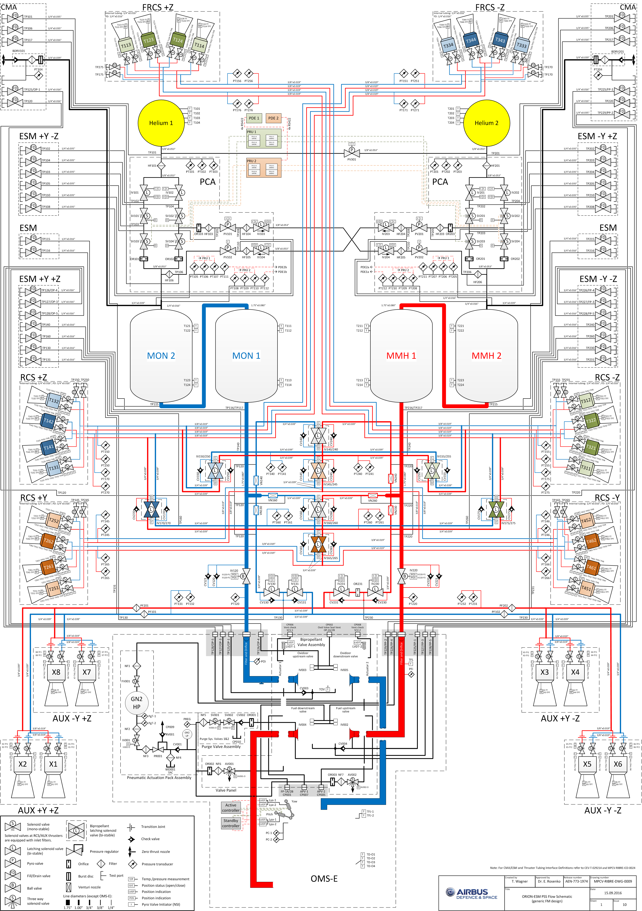
Which System Engineering tools & methods exist?
Schematics / Architecture / Diagrams:
Important element for system description
are block diagrams,
flow schematics
L1 – Introduction in Spacecrafts
Space Propulsion ENG-510

Slide 52
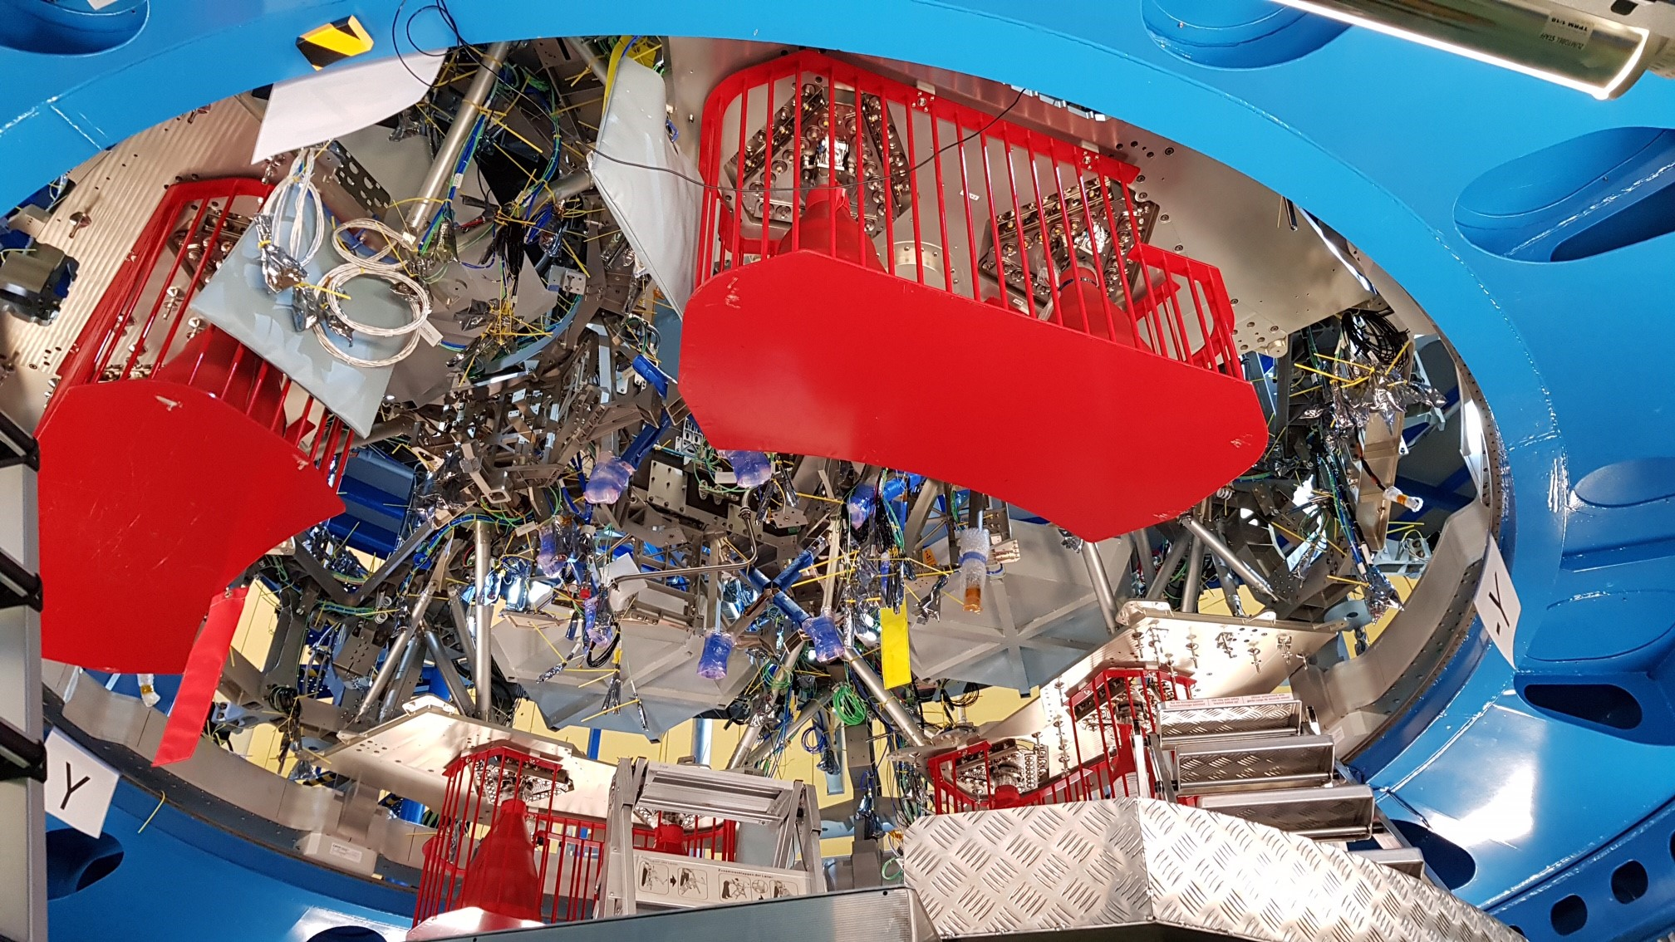
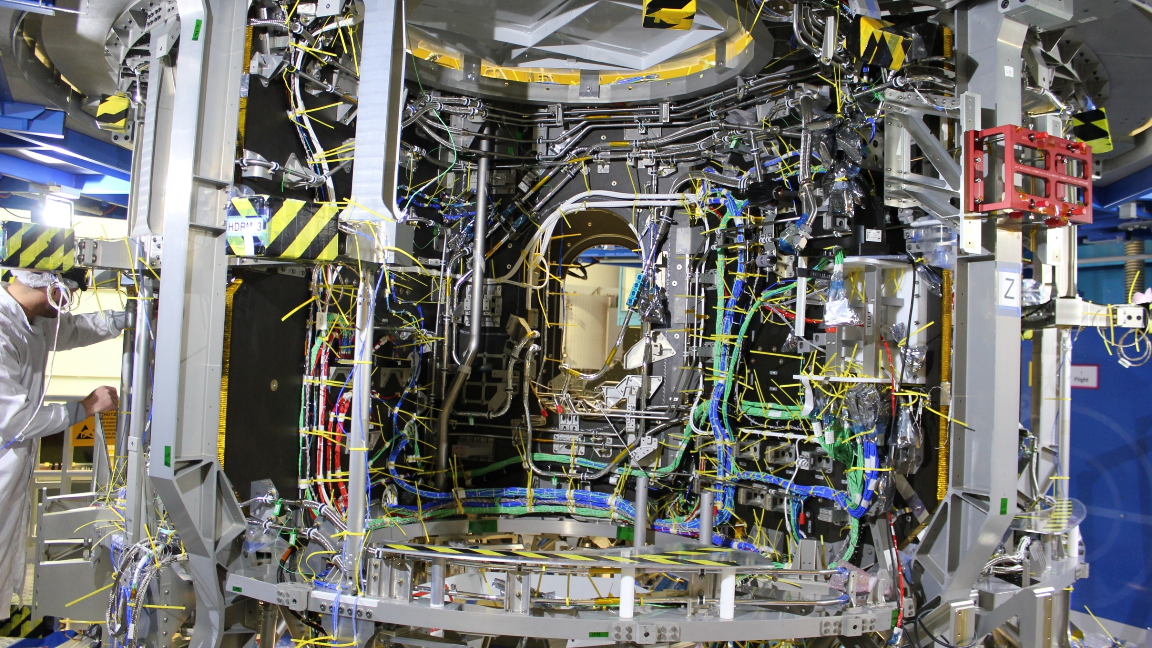
Which System Engineering tools & methods exist?
Schematics / Architecture / Diagrams:
But reality looks different…
L1 – Introduction in Spacecrafts
Space Propulsion ENG-510

Slide 53
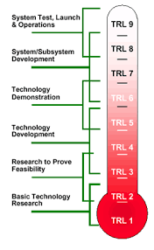
Which System Engineering tools & methods exist?
TRL / IRL:
Technology readiness levels are a method for
estimating the maturity of technologies during
the acquisition phase of a program, developed at
NASA during the 1970s
The use of TRLs enables consistent, uniform
discussions of technical maturity across different
types of technology
L1 – Introduction in Spacecrafts
Space Propulsion ENG-510

Slide 54
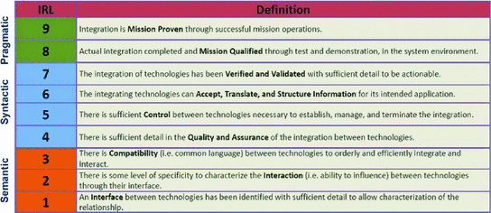
Which System Engineering tools & methods exist?
TRL / IRL:
Integration readiness levels describes the integration maturity of a developing technology with another technology, developing or mature
IRLs not only provide a check to where the technology is on an integration readiness scale, but also a direction for improving integration with other technologies. As TRL has been used to assess the risk associated with developing technologies, IRL is designed to assess the risk of integration
L1 – Introduction in Spacecrafts
Space Propulsion ENG-510

Slide 55
Which System Engineering tools & methods exist?
Equipment Qualification Category (EQC):
The metric Equipment Qualification Category (EQC) follows the ECSS definition (E-ST-10-02C and reflects the qualification status of the equipment chosen
L1 – Introduction in Spacecrafts
Space Propulsion ENG-510

Slide 56
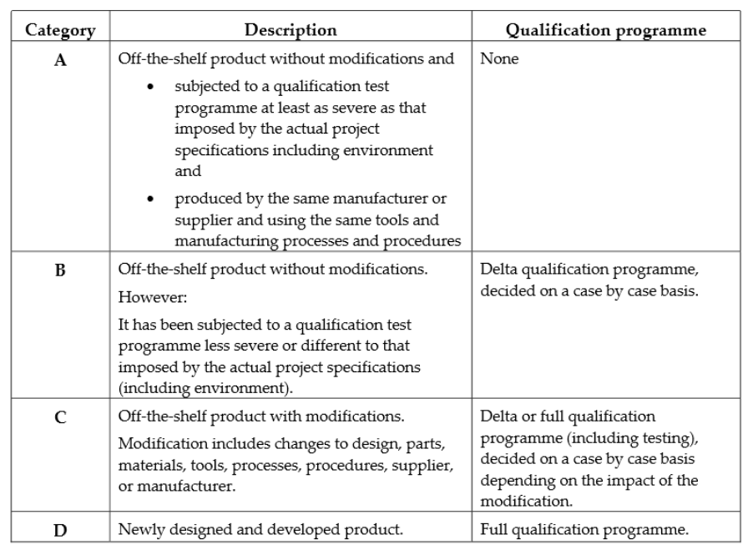
Which System Engineering tools & methods exist?
L1 – Introduction in Spacecrafts
Space Propulsion ENG-510

Slide 57
Which System Engineering tools & methods exist?
Advanced Degree of Difficulty (AD²):
The metric AD² aims to support the program risk assessment
The levels of risks associated with AD² are described in terms of the experience base of the developers / equipment manufacturers, i.e. have they done this before?
L1 – Introduction in Spacecrafts
Space Propulsion ENG-510

Slide 58
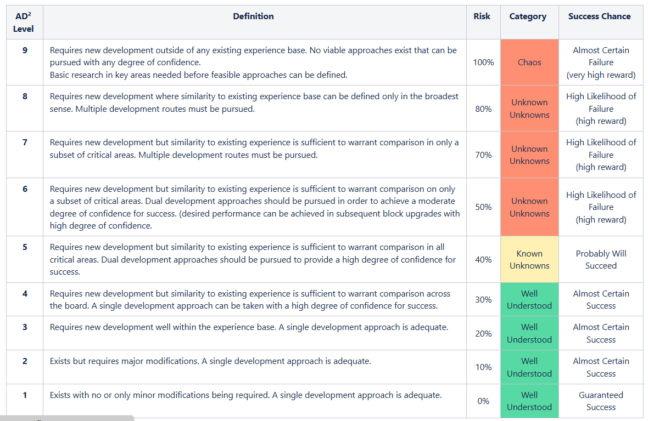
Which System Engineering tools & methods exist?
L1 – Introduction in Spacecrafts
Space Propulsion ENG-510

Slide 59
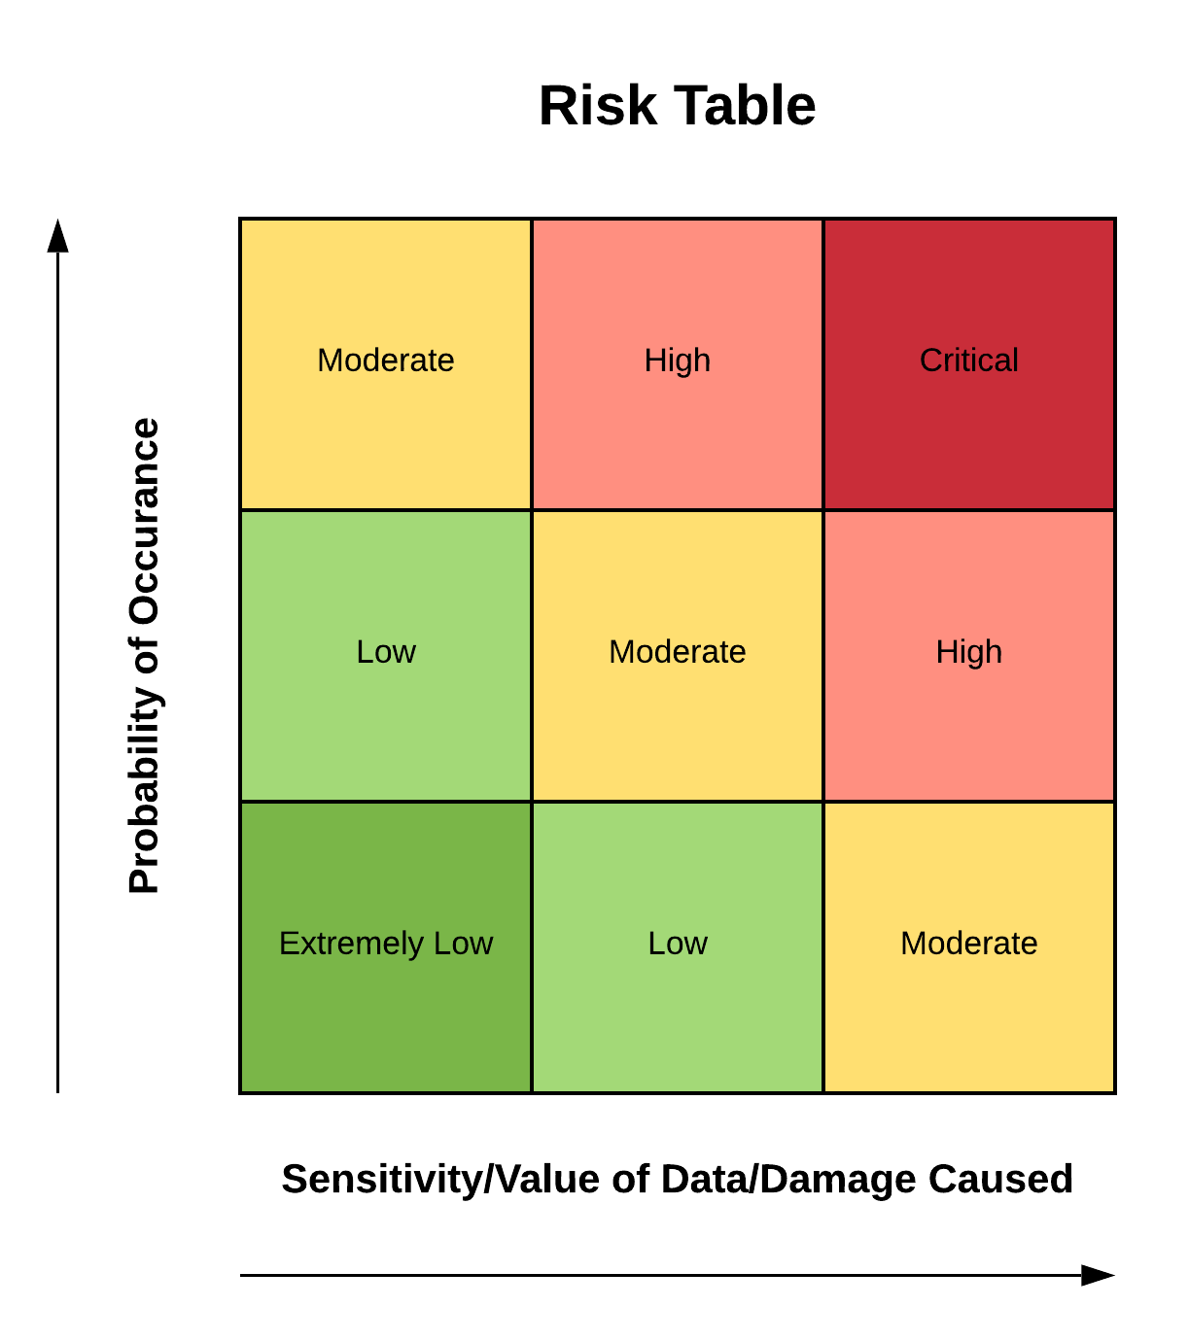
Which System Engineering tools & methods exist?
Risk Analysis:
Detailed risk analysis needs to be performed
following the assessment of TRLs / IRLs /
EQC / AD² considering:
  Risk identification
  Risk analysis (Probability / severity)
  Risk handling (risk mitigation)
  Risk monitoring
L1 – Introduction in Spacecrafts
Space Propulsion ENG-510

Slide 60
Which Subsystems are needed?
Overview:
L1 – Introduction in Spacecrafts
Space Propulsion ENG-510
ESM
MSR-ERO
SLS

Slide 61
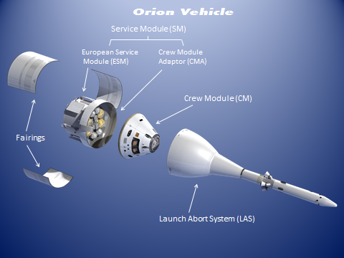
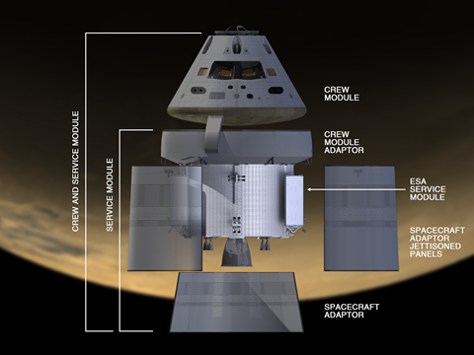
Which Subsystems are needed?
Overview:
First it is important to define L0 (out-of-scope) and
afterwards L1 (in-scope) as well as L2 (out-of scope)
The Orion vehicle (L0) includes the following
elements:
  Crew Module (CM) and Crew Module Adapter
  (CMA) – LM
  European Service Module (ESM) – Airbus DS (L1)
    OMS-E – NASA (L2)
    Prop Tanks – AGG (L2)
  Launch Abort System (LAS) – Lockheed Martin
  Spacecraft Adapter (SA) – Lockheed Martin
  Spacecraft Adapter Jettison Fairing (SAJ) – LM
L1 – Introduction in Spacecrafts
Space Propulsion ENG-510

